Slide 1

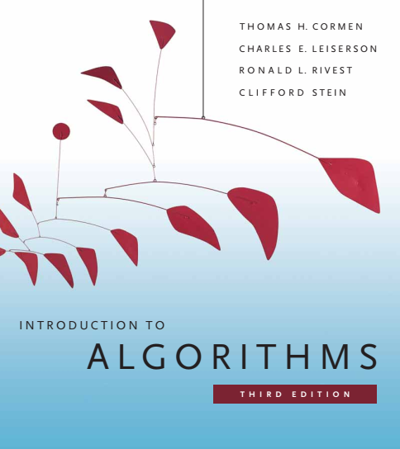
Design and Analysis of Algorithms
Dr. Sajid Iqbal
sajidiqbal.pk@gmail.com
Reference Book
Introduction to Algorithms 3rd Edition By Thomas H. Cormen et. al.
https://mitpress.mit.edu/books/introduction-algorithms-third-edition
COMEDXD

Slide 2
Mathematical induction
A method to prove statements

Slide 3

What is Mathematical Induction
One of the best analogies to think induction as ladder that has n steps
When you climb up the ladder, you have to step on the lowest step and need to go up based on it
Assume that If you can reach to step k then you can reach to next step k+1
After we climb up the several steps, we can go up further by assuming that the step you are stepping on exists.

Slide 4
The induction
Base Case : The first step in the ladder you are stepping on
Induction Hypothesis : The steps you are assuming to exist
Weak Induction : The step that you are currently stepping on
Strong Induction : The steps that you have stepped on before including the current one
Inductive Step : Going up further based on the steps we assumed to exist

Slide 5
Components of Inductive Proof
Base Case: One or more particular cases that represent the most basic case.
Induction Hypothesis: Assumption that we would like to be based on. (e.g. Let’s assume that T(k) holds)
Inductive Step: Prove the next step based on the induction hypothesis. (i.e. Show that Induction hypothesis T(k) implies T(k+1))

Slide 6
Weak induction vs strong induction
The difference only appears in induction hypothesis (2nd step).
In weak induction, we only assume that particular statement holds at kth step,
In strong induction, we assume that the particular statement holds at all the steps from the base case to kth step

Slide 7
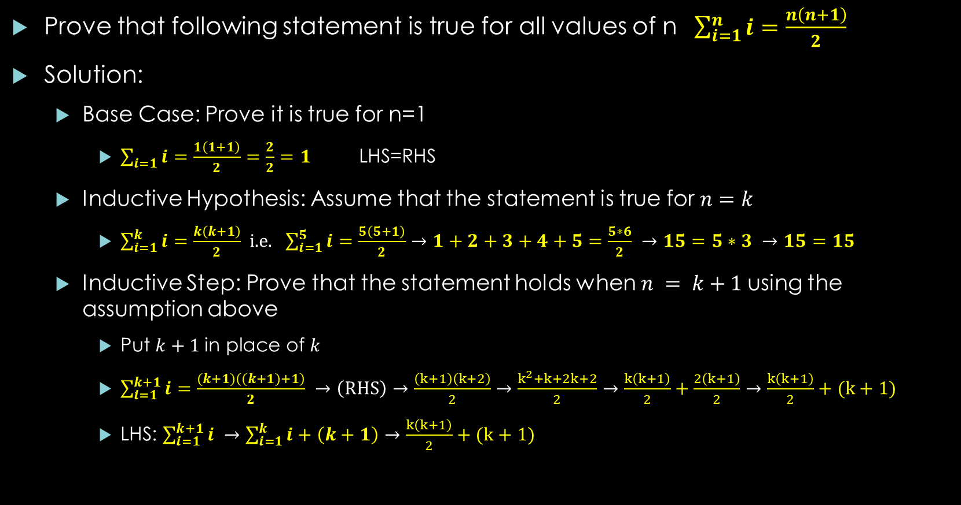
Weak Induction-Example
Prove that following statement is true for all values of n $\begin{aligned} \begin{aligned} \begin{aligned}\begin{aligned}\sum_{i=1}^{n}{i}=\frac{n\left(n+1\right)}{2}\#\end{aligned}\#\end{aligned} \#\end{aligned} \#\end{aligned}$
Solution:
Base Case: Prove it is true for n=1
$\sum_{i=1}{i}=\frac{1\left(1+1\right)}{2}$ $=\frac{2}{2}=1$ LHS=RHS
Inductive Hypothesis: Assume that the statement is true for $n=k$
$\sum_{i=1}^{k}{i}=\frac{k\left(k+1\right)}{2}$ i.e. $\sum_{i=1}^{5}{i}=\frac{5\left(5+1\right)}{2}→1+2+3+4+5=\frac{5∗6}{2} →15=5∗3 →15=15$
Inductive Step: Prove that the statement holds when $n = k+1$using the assumption above
Put $k+1$in place of $k$
$\sum_{i=1}^{k+1}{i}=\frac{(k+1)\left((k+1)+1\right)}{2} →\left(RHS\right)→\frac{\left(k+1\right)\left(k+2\right)}{2}→\frac{k^{2}+k+2k+2}{2}→\frac{k\left(k+1\right)}{2}+\frac{2\left(k+1\right)}{2}→\frac{k\left(k+1\right)}{2}+(k+1)$
LHS: $\sum_{i=1}^{k+1}{i} →\sum_{i=1}^{k}{i}+\left(k+1\right)→\frac{k\left(k+1\right)}{2}+(k+1)$
So proved!

Slide 8

Strong Induction
Prove by induction that $P\left(n\right)=n≥2 ∀ n∈N$can be factored into primes.
Solution:
Base Case : Prove that the statement holds when n = 2
We are proving P(2). 2 itself is a prime number, so the prime factorization of 2 is 2. Hence, the statement P(2) holds.
Induction Hypothesis : Assume that for all integers less than or equal to k, the statement holds.
for weak induction, the assumption was only about the case when $n = k$.
Inductive Step : Consider the number $k+1$
Case 1 : $k+1$ is a prime number. The number is a prime factorization of itself. Therefore, the statement $P(k+1)$ holds. i.e. $7→7∗1$
Case 2 : k+1 is not a prime number. We know that k+1 is a composite, so k + 1 = p × q.
for all integers less than or equal to k, the statement holds.
which means both p and q can be expressed as prime factorizations.
In this sense, because k+1 is a product of p and q, by multiplying the prime factorizations of p and q, we can get the prime factorization for k+1 as well.
Example: $18 →2∗9 →\left(1∗2\right)∗\left(3∗3\right)→1,2,3 are prime factors$

Slide 9
Thanks for watching
Dr. Sajid Iqbal
Assistant Professor
Department of Computer Science
Bahauddin Zakariya University, Multan
Allah Hafiz

